Slide 1



Investor Opportunity
Presented By :- Khushi Shukla

Slide 2


Business Context
The chocolate industry is highly competitive.
Understanding revenue trends, product performance, and sales effectiveness is critical.
This analysis identifies top markets, products, and salespersons to guide business strategy.

Slide 3

Problem Statement
How do monthly revenues trend over time?
Which countries contribute the most revenue?
Which products drive revenue across markets?
Who are the top-performing salespersons?
What strategies can improve growth in weaker areas?

Slide 4
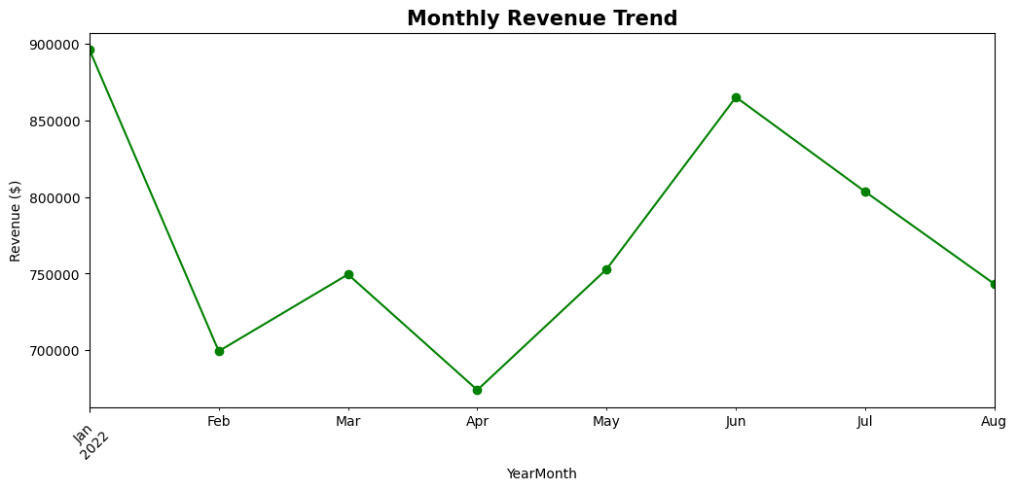
1) Monthly Revenue Trend
Revenue peaked in Jan ($900K) and Jun ($865K).
Lowest revenue in Apr ($675K).
Seasonal fluctuations indicate opportunities for festival-based promotions.
Recommendation:- Focus on stabilizing revenue dips by introducing campaigns in low months.

Slide 5
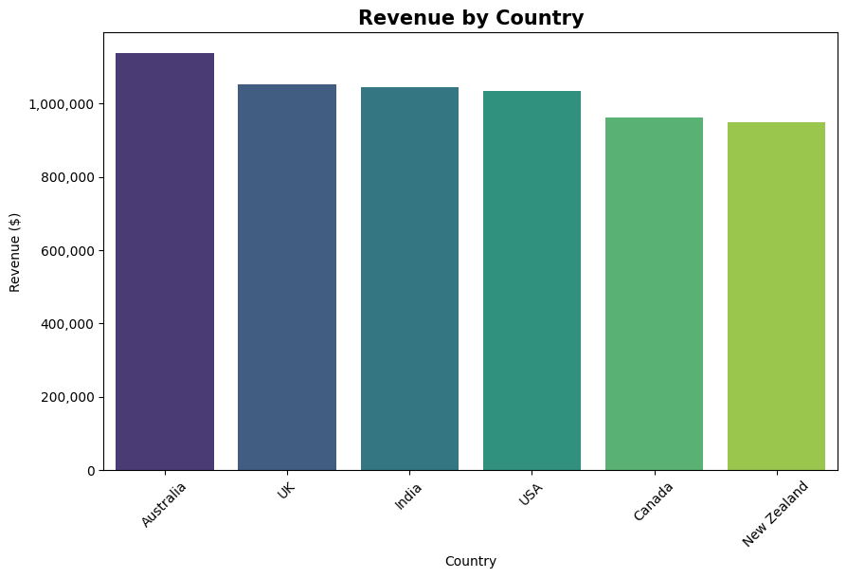
2) Revenue by Country
Australia leads with $1.14M revenue.
UK, India and USA follow closely.
Canada & New Zealand lag behind.
Recommendation:- Expand distribution/marketing in Canada & New Zealand while maintaining stronghold in Australia.

Slide 6
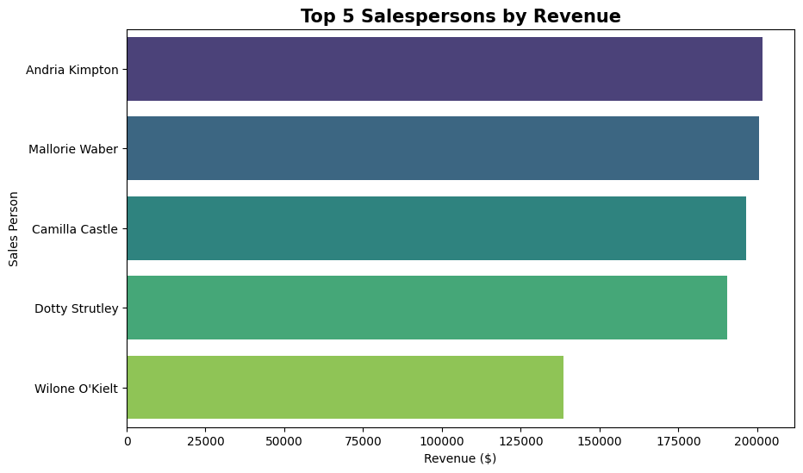
3) Top Salespersons by Revenue
Andria Kimpton is top performer ($200K revenue).
Mallorie & Camilla also strong contributors.
Wilone O’Kielt lags behind.
Recommendation:-
Recognize & replicate Andria’s strategies.
Provide training & mentoring for low performers.

Slide 7
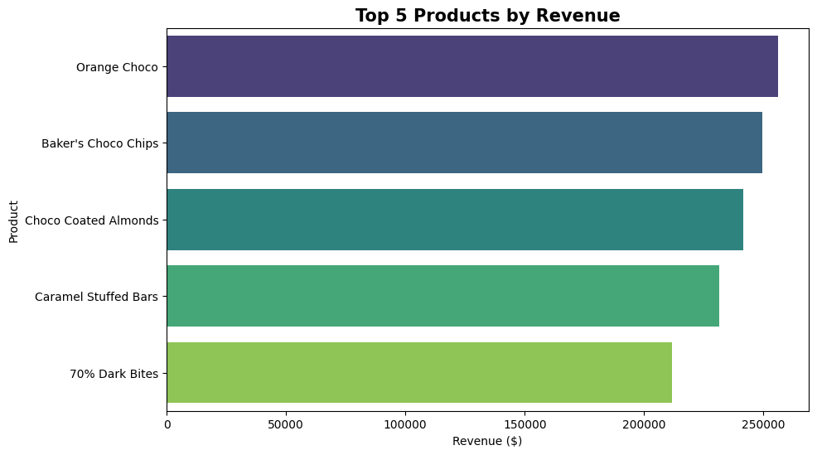
4) Top Products by Revenue
Orange Choco is the top-selling product.
70% Dark Bites has the lowest revenue among the top five.
The revenue gap between the top three products (Orange Choco, Baker's Choco Chips, and Choco Coated Almonds) is very narrow.
Recommendations: -
Study what makes Orange Choco and Baker’s Chips successful to repeat that with other products.
Investigate why 70% Dark Bites is weaker (low demand, pricing or supply issues).
Since the top 3 are close, even a small promotion can change rankings.

Slide 8
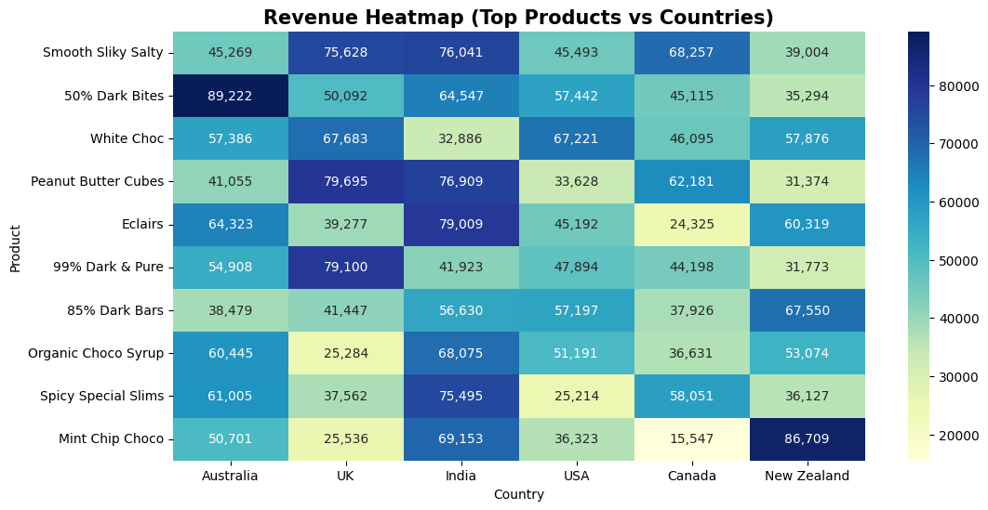
5) Product Performance
50% Dark Bites dominates in Australia.
Mint Chip Choco strong in New Zealand.
Eclairs & Peanut Butter Cubes perform well in India.
Recommendation:-
Different countries prefer different chocolates → adopt localized marketing strategy.
Focus inventory planning based on country-specific bestsellers.

Slide 9
Insights Summary
Sales drop in April – need campaigns in weak months.
Australia is the largest and most profitable market.
Product preferences change by country.
Salesforce performance is uneven due to scope for training.
Top products are close in revenue, showing strong competition.

Slide 10
Business Solutions
Run promotions in weak
months to boost sales.
Use different product strategies
for each country.
Expand marketing and distribution
in Canada & New Zealand.
Train weaker salespeople
and reward high performers.

Slide 11


Thank you
THANK YOU ☺
THANK YOU ☺
Sonu Jain
sonu@fourthcoffee.com
405-555-0145

